Slide 1
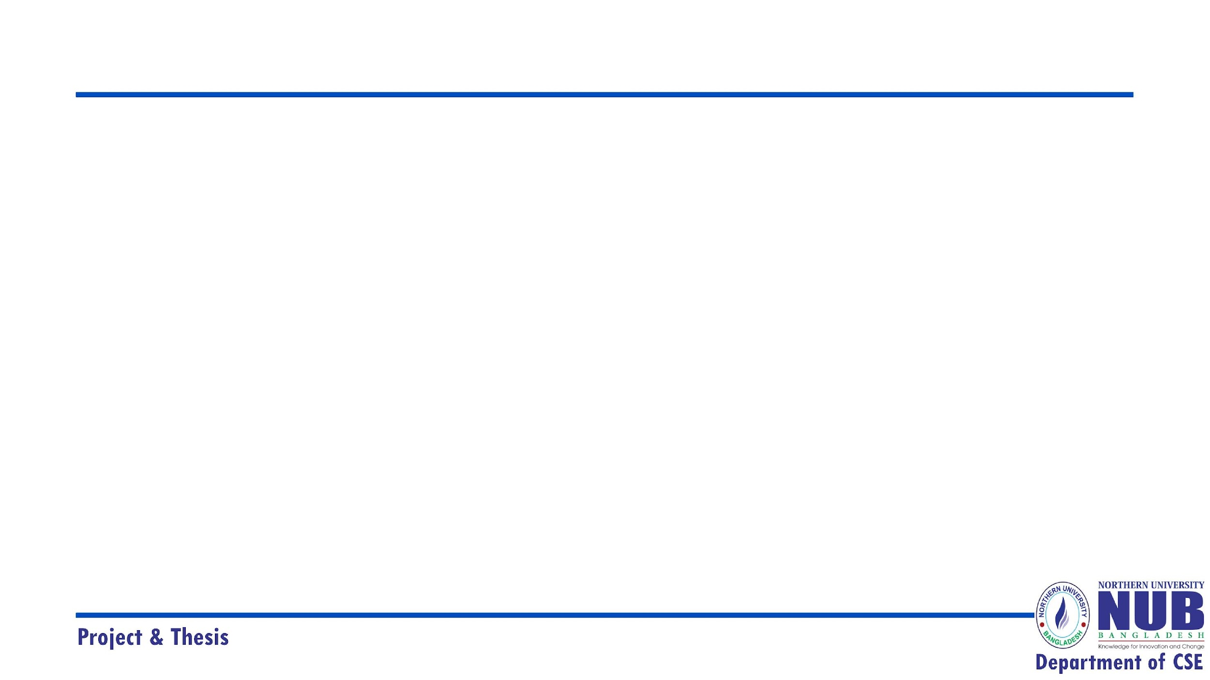
Northern University Bangladesh
Smart Gadget Store
Present by
Bikash Haldar(21180200847)
Payel Mujumdar(42180200815)
Muhammad Nesar Uddin(41180101191)
Sadia Akhter Bristy(42190101057)
Supervised by
Sumya Akter
Lecturer
Department Of CSE
Northern University Bangladesh

Slide 2


Slide 3

Topics
Introduction
Objectives
Purpose
Main Function of the system
Login Page
Dashboard
Database
Tools used for this system
Limitation
Conclusion
Reference

Slide 4
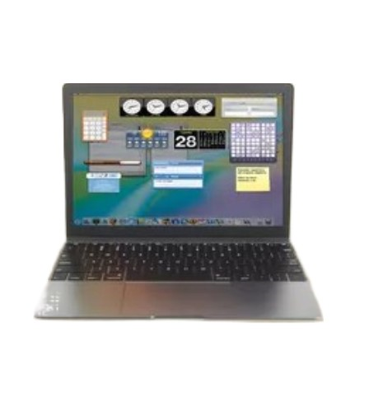
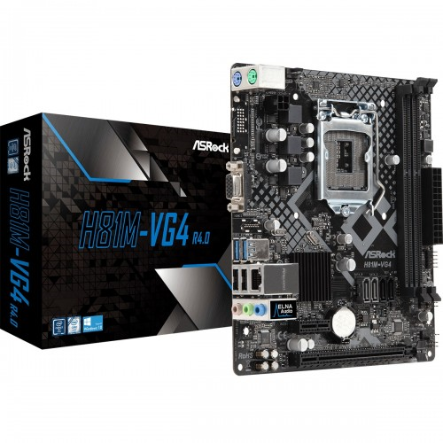
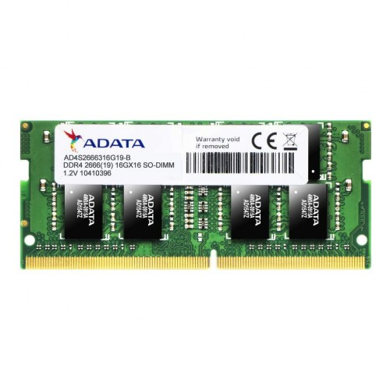
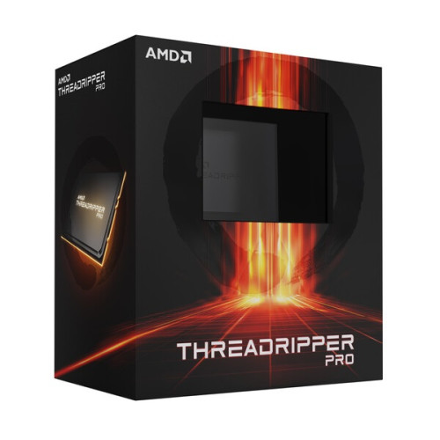
Introduction
What is E-Gadget?
E-gadget is a product or an e-commerce platform that emerged after my last update, I recommend checking online reviews, customer feedback, and the website itself for the most accurate and up-to-date information. Additionally, make sure to verify the legitimacy and reputation of the website before making any purchases, as there are many online platforms with similar names, and some may not be trustworthy.
Our Main Products
Laptop
Motherboard
RAM
Processor

Slide 5
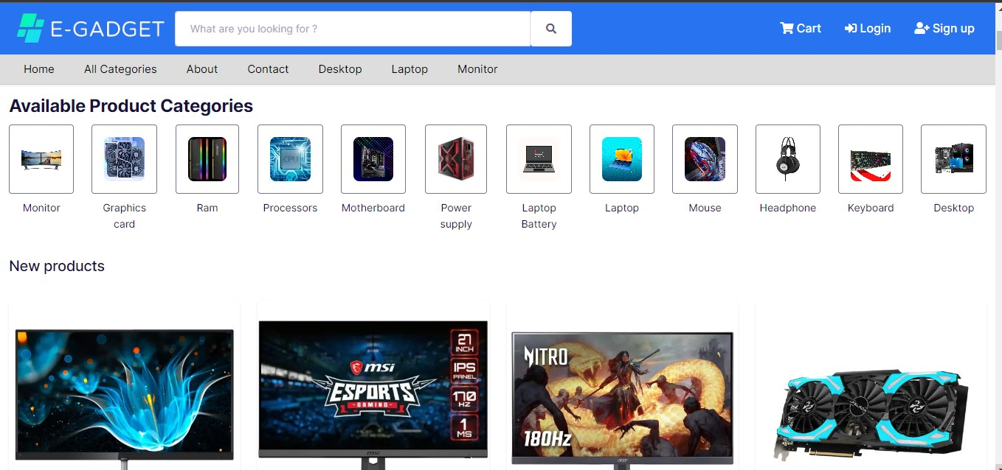
Our Available products

Slide 6
Objectives
01
The primary goal of an e-commerce platform is usually to sell products or services and generate revenue.
Sales and Revenue Generation
02
E-commerce platforms aim to attract new customers and retain existing ones through marketing strategies, customer service, and user experience improvements.
Customer Acquisition and Retention
03
Establishing and enhancing the brand's presence is often a key objective. This involves creating a positive brand image and reputation.
Brand Building
04
Staying abreast of technological advancements and incorporating innovations, such as mobile apps or advanced search functionalities, can be a goal for e-commerce platforms.
Innovation and Technology

Slide 7
Purpose
The purpose of e-commerce in the gadget industry is to provide a convenient platform for buying and selling electronic devices online. It enables consumers to browse a wide range of gadgets, compare prices, and make secure transactions from the comfort of their homes. E-commerce also allows gadget manufacturers and retailers to reach a global audience, increasing market visibility and potential sales. Additionally, it facilitates efficient inventory management and customer service, contributing to a seamless shopping experience for tech enthusiasts.

Slide 8



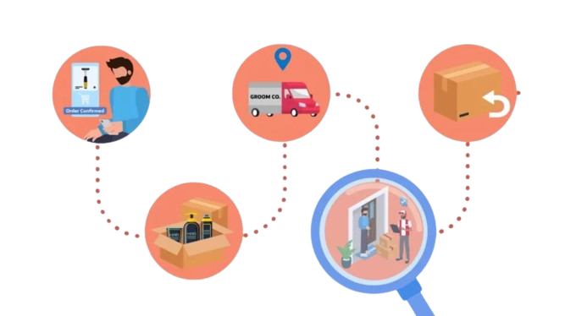

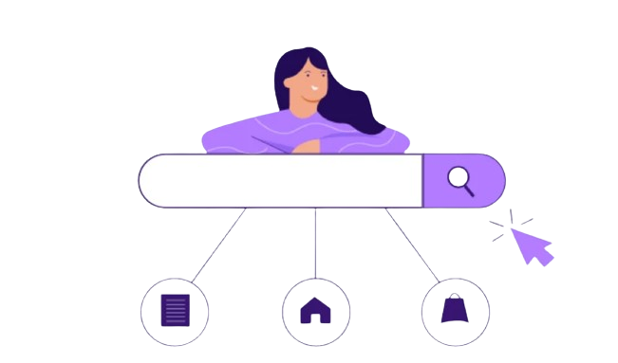
Main Function of the system
The main function of an e-gadgets system is to facilitate online buying and selling transactions. Here are the primary functions and key features of an e-commerce system:
product catalog management
User Account Management
Shopping Cart and Checkout
order processing and fulfillment
Customer Reviews and Ratings
Search and Navigation

Slide 9
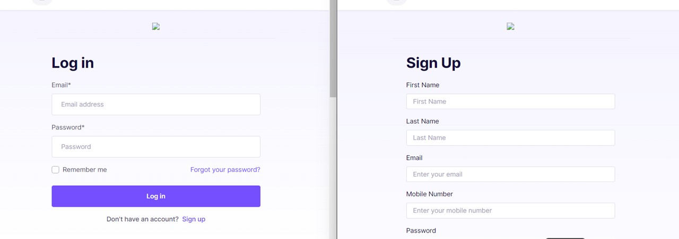
Login Page
A login page is a web page or an entry page to a website that requires user identification and authentication, regularly performed by entering a username and password combination. Logins may provide access to an entire site or part of a website. Logging in not only provides site access for the user, but also allows the website to track user actions and behavior.

Slide 10
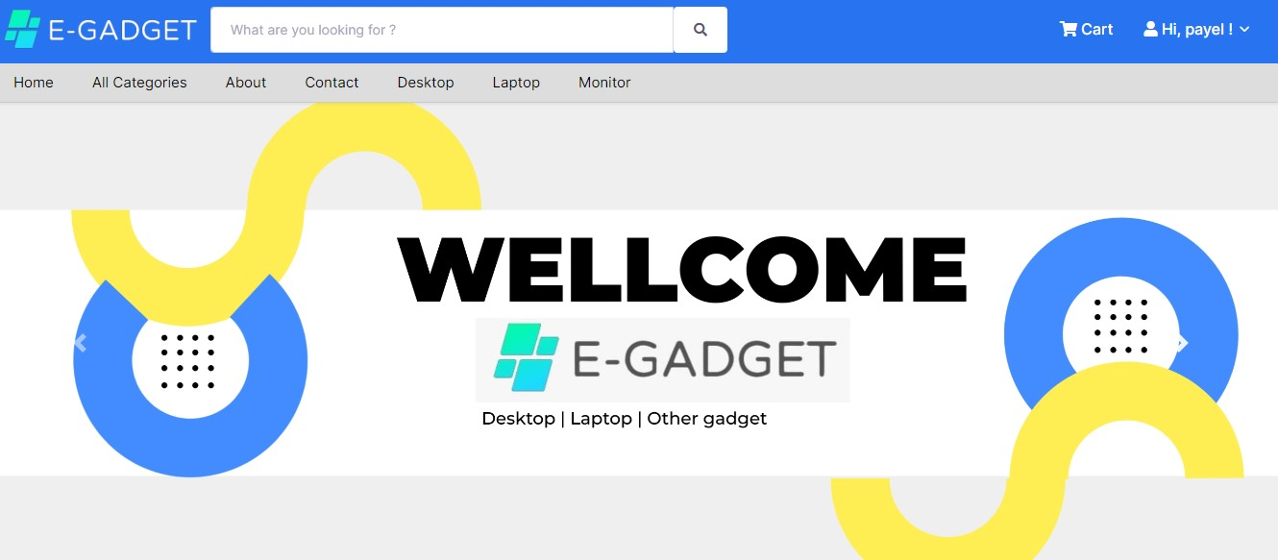

Slide 11
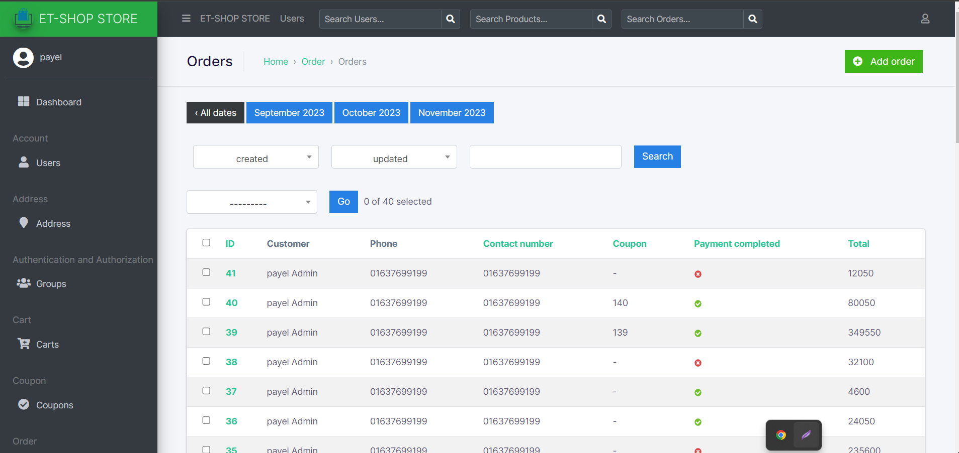
Dashboard
Dashboard is usually the one page that the users see first thing in the web application. It is the page that shows the analysis of the application’s data, trends, summaries etc. In many cases it dynamically reports important pieces of data from the web application. From the Dashboard the users can drill down to get more information. A dashboard is a visual, at-a-glance representation of key data points. A dashboard should confine its display to a single screen with no need for scrolling or switching among multiple screens, might seem arbitrary and a bit finicky, but it is based on solid and practical rationale.

Slide 12
Administration Page
Website administration is the process of maintaining a website. This process is done by the website administrator. Website administrators are responsible for running the site after completion. They are registered users who are members of the Administrators role. These users have full access to manage the site including adding, deleting and editing all pages and modules. Administrators also have access to the Admin pages located on the main menu. Admin is the role with the highest level of access to your website. This means that admin can control site-wide settings like the design of your website and the homepage layout. They can add and delete other admin users, and can approve or deny edits made by authors.

Slide 13
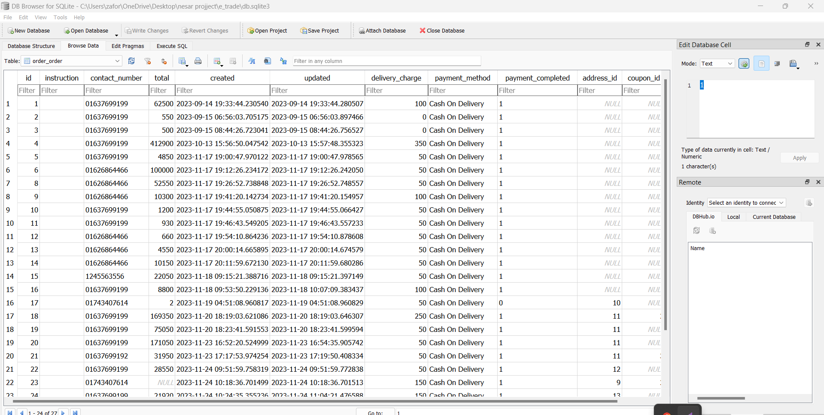
SQLite Database

Slide 14
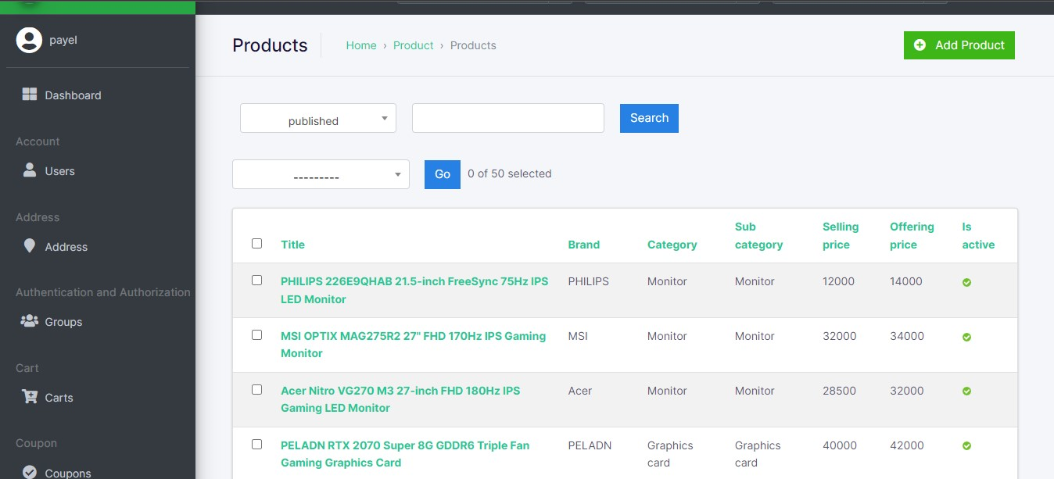

Slide 15
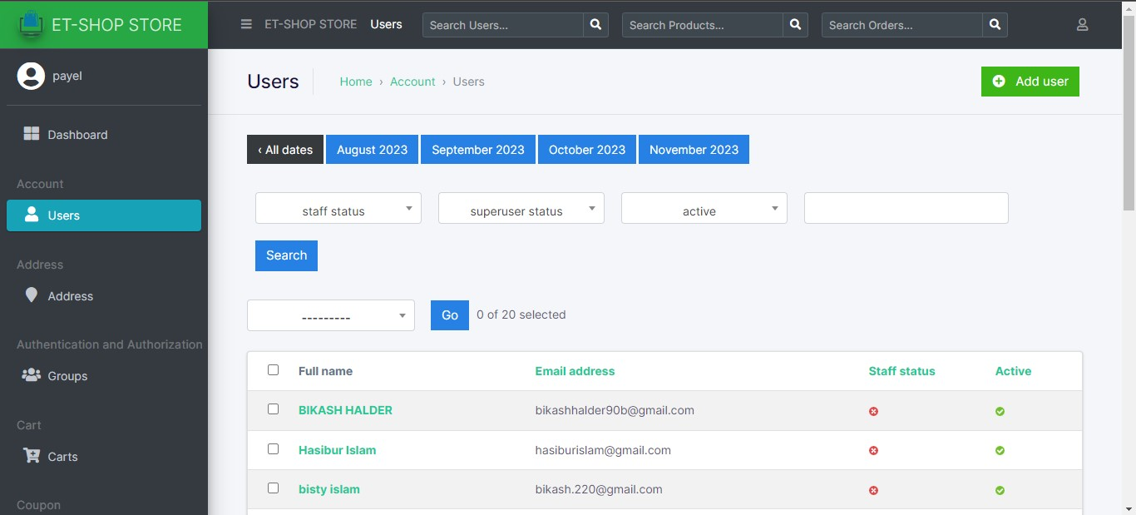

Slide 16





Tools used for this system

Slide 17

Limitation
⮚ Technical Issues: E-commerce platforms may face technical challenges such as website downtime, slow loading times, or glitches, which can impact user experience and lead to customer dissatisfaction.
⮚ Security Concerns: Security is a major concern for e-commerce platforms due to the sensitive nature of customer information. Ensuring robust security measures to protect customer data is crucial.
⮚ Customer Trust: Building and maintaining trust is essential. Any issues related to product quality, customer service, or fulfillment can impact the trust customers place in the platform.

Slide 18
Conclusion
If "E-gadget" is a platform that emerged after my last update, and you are looking for information about it, I recommend visiting the official website of E-gadget, checking customer reviews, and contacting their customer support for the latest and most accurate details.
In general, when evaluating an e-commerce platform, consider factors such as the range of products offered, website functionality, user experience, customer reviews, security measures, and the overall reputation of the platform. Additionally, ensure that the platform complies with relevant regulations and provides transparent terms of service.

Slide 19

Reference
https://www.ryanscomputers.com/
https://www.techlandbd.com/
https://daraz.com.bd/
https://w3schools.com/
https://docs.djangoproject.com/en/4.2/
https://www.startech.com.bd/

Slide 20


Slide 21

Any Question

